Slide 1



Analysis of Marketing Campaign
Notes:
(Note: these notes are to share methodology and were not used for memorization or read during presentation, they are for tying story with a thread and baseline for practice sessions)
Hi ____ ! thank you for joining me and sharing your time!
This Project is for an outlet with wide range of products, mediums of sale like store, web and so on, and with a customer base across the globe.
.
Now prior to the last marketing campaign there were 5 other campaigns with various levels of success.
However, the Last campaign was the most successful one yet.

Slide 2
Problem Statement
How can we increase revenue generated by our next marketing campaign with a focus on identifying key customer demographic?
Approach
Data Cleaning
Exploring and Identyfing Key Factors
Developing Prediction Models
Notes:
Our goal is to build on success of the last campaign and make sure that the future campaigns are as successful as they can be.
We want to maximize the number of acceptance by the customers or the acceptance rate by Identyfing key customers.
We started by cleaning the large amount of data we had, and then began exploring different factors and identified key factors with respect to the problem statement.
After that we built not one but two prediction models to help predict behavior of customers in future.
Let’s begin exploring!!

Slide 3
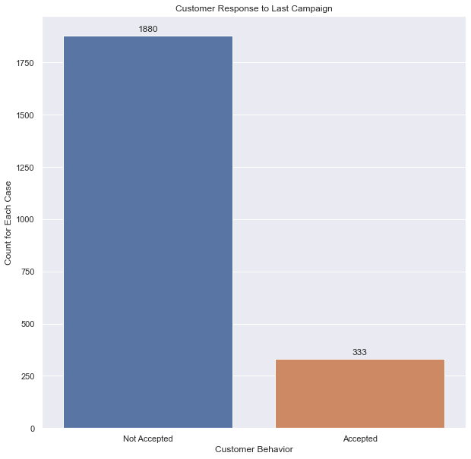
Customer Response to Last Campaign
Total Customer Count: 2213
Acceptance Rate: 15.05%
Notes:
So, when we look at how last campaign performed, even though last campaign was the most successful one yet.
We see an acceptance rate of about 15% which means a little over 300 customers out of nearly 2200 customers accepted the marketing campaign.
Clearly there is a room for improvement.

Slide 4
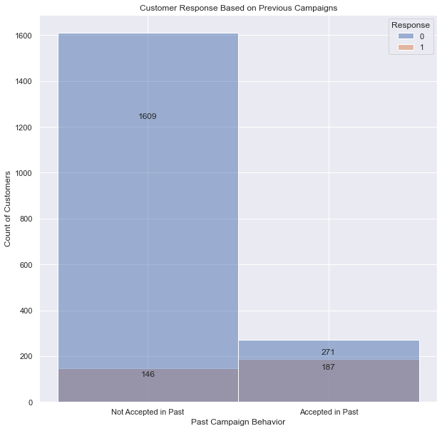
Customer Likelihood to Accept More Than One Campaign
Customers who Accepted Campaign in Past:
40.8% Acceptance Rate
Customers who did NOT Accept Campaign in Past:
8.3% Acceptance Rate
Notes:
I personally really like this chart as it shows that customers who had accepted campaign in past have nearly 41% acceptance rate compared to customers who did not accept past campaigns and have an 8% acceptance rate.
That is a significant difference between the two groups, and it shows that customers do see a value in accepting the campaign. Customers are more likely to return for future campaigns having accepted one in the past.

Slide 5
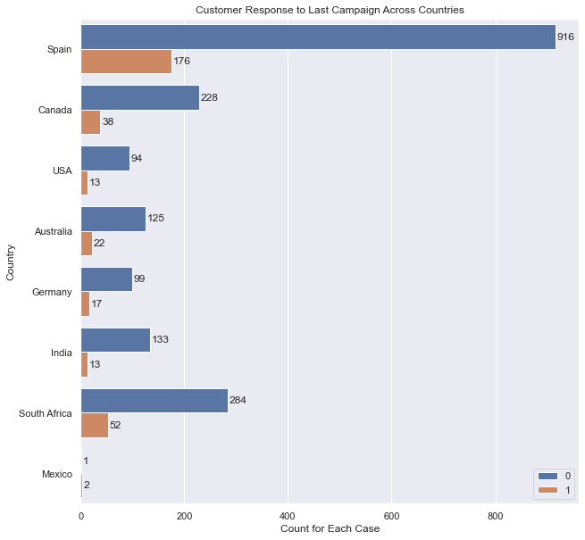
Campaign Performance Across Different Countries
Spain makes up for ~ 1100 or 50% of customer base
India has the lowest Acceptance Rate: 8.9%
Rest excluding Mexico are between 14 and 17%
Notes:
Here we can see how different our customer base is across different nations.
Spain makes up for nearly half of the customer base with 1100 customers, and it’s important to address that customer base differently than the one in Mexico, USA or India, which had lowest acceptance rate. Moving forward..

Slide 6
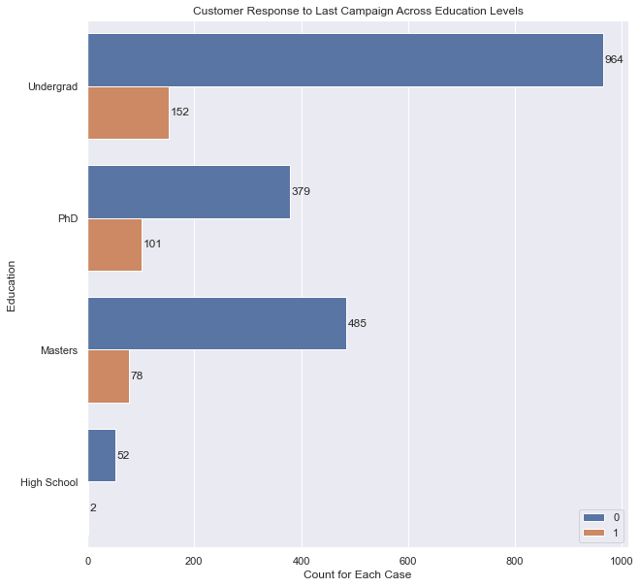
Campaign Performance Across Education Levels
Customers with PhD have an acceptance rate of 21%
Customers with Undergrad and Masters have acceptance rate of 14%
Customers with High School Education have an acceptance rate of less than 4%
Notes:
.. It was surprising to see difference in acceptance rate across education levels with high school graduates having an acceptance rate of less than 4%, while PhD holders had an acceptance rate of 21% with 101 out of 480 customers accepting the campaign.

Slide 7
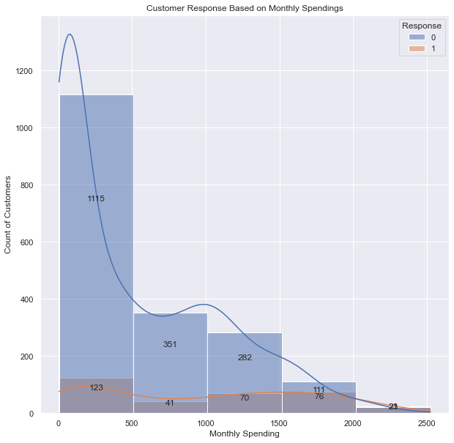
Customer Acceptance Across Monthly Spending (USD)
Acceptance Rate for less than 1000 : 10.06%
For 1000 – 1500 : 19.8%
For 1500 – 2000 : 40.6%
For 2000 – 2500 : 85.2%
Notes:
I feel that the last graph is somewhat explained by this graph, where we can see acceptance rate for different monthly spending.
Monthly spending does seem to have a high influence on the acceptance rate with customers less than 1000 USD in monthly spending having an acceptance rate of about 10%, while customers between 1500 to 2000 in monthly spending had an acceptance rate of 40.6%.
Finally, there were only 27 customers with monthly spending greater than 2000 USD and 23 of those accepted the campaign, with an acceptance rate of 85%.

Slide 8
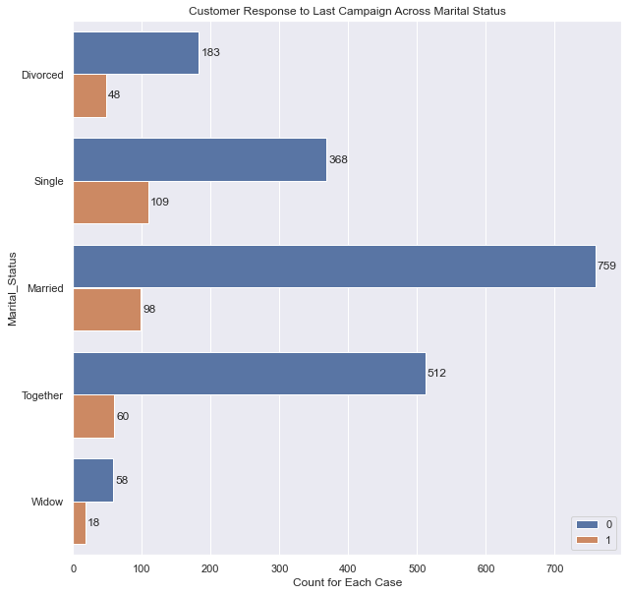
Customer Acceptance Across Marital Status
Customers who are single, divorced or widows have acceptance rate of 20-24%
Customers who are married or together have Acceptance Rate of 10-12%
Notes:
Here we can see the acceptance rate based on relationship status.
Customers who are not in a relationship, single, divorced and widows have a higher acceptance rate of 20-24%, nearly twice of those in a relationship either married or living together.

Slide 9
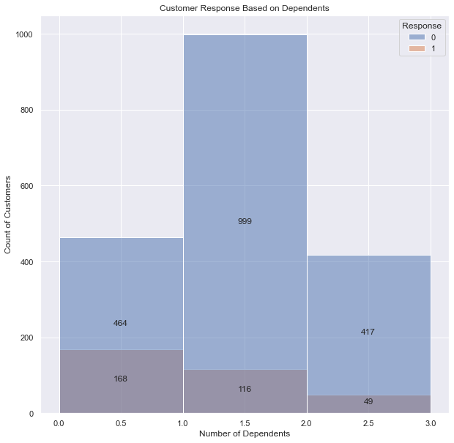
Customer Response Based On Dependents
Customers with no Dependents have Acceptance Rate: 26.1%
Customers with 1 or more Dependents have Acceptance Rate: 10.5%
Notes:
On this slide we can see customer response based on number of dependents.
In continuation from the last slide, we see that number of dependents also seem to impact the acceptance of marketing campaign with customers having no dependents having an acceptance rate of 26% while those with 1 or more dependents make up bigger portion of customer base and have an acceptance rate of 10.5%.

Slide 10
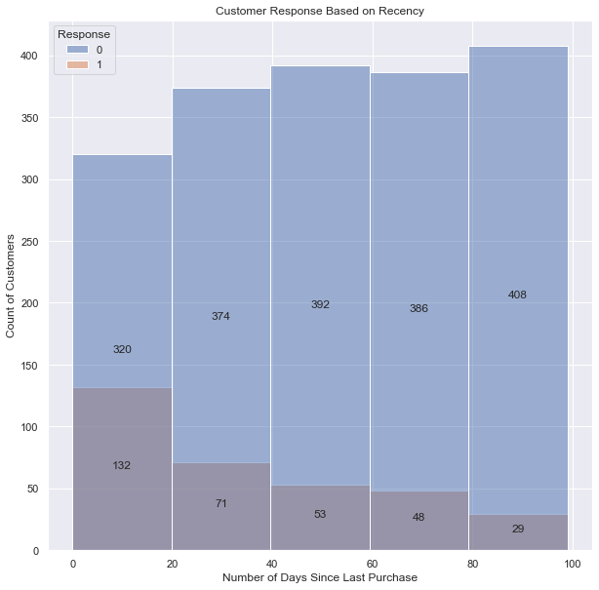
Customer Response Based on Recency
Acceptance Rate for most Recent Customers 29.2%
Customers with 80+ days since last purchase have acceptance rate of 11%
Notes:
Finally, when it comes to recency, we see a clear decline in acceptance as number of days since last purchase increase. Customers who made a purchase in last 20 days have an acceptance of nearly 29%, while those with a purchase over 80 days at 11%. This decline indicates importance of when the marketing campaign is launched based on customer activity.

Slide 11
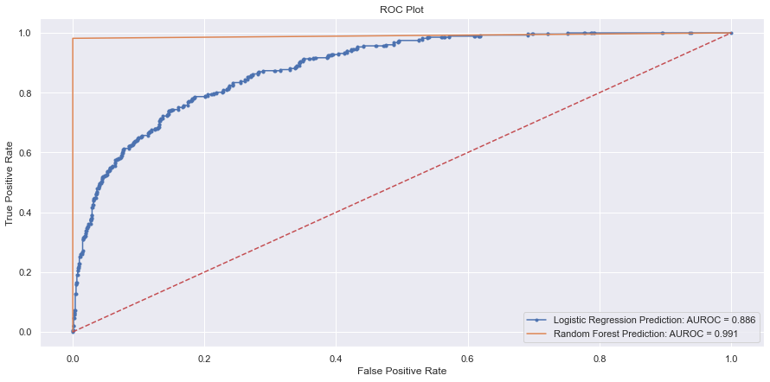
Prediction Modeling
Train Data = 85% of Available Data
Our best model has a 99.1% chance of Identyfing Customers who will Accept the Campaign
Notes:
So, after exploring the key factors we enter the world of prediction, this might feel a bit daunting at first, but it is simpler than it looks.
One simple way to look at it is the further up and away our model is from the red line which denotes flipping a coin, the better the model is.
We see that both our models do a significantly better job than the red line, which is always a good thing. I don’t want to be replaced by a coin flip ☺
We can also see that the model in orange is further away from red line, this model identifies nearly 99% of customers who will accept or not accept the campaign.
Now these performances are for the data used to build the model, since we don’t have data from future, we used 85% of data to build this model and rest to test it!
That’s where the real challenge and the drop comes in, so exciting stuff ahead! Are we ready to find out how we did on the test?

Slide 12
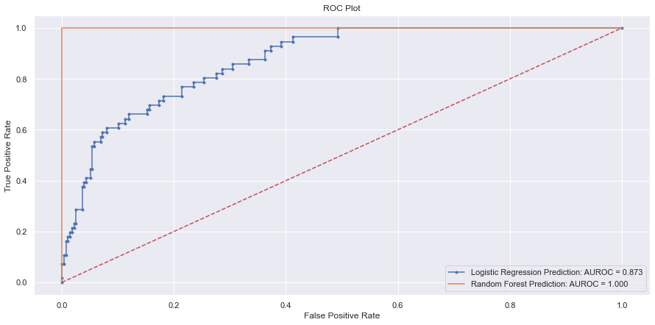
Testing Prediction Model
Test Data = 15% of Available Data
Models Stood up to test data!
Our best model identified customers who accepted and did not accept campaign by 100%
Notes:
So, our model stood up to the test data! Yay!
Honestly better than I expected it to, the one in blue had a slight dip however the one in orange predicted with 100% accuracy.
Now let’s remember that this was for this test data and as we use new data results will probably change, but we seem to be in the ideal range!
Now we can use this while controlling certain factors to get a prediction for how we might do moving forward.
Although nothing beats actual successful future marketing campaigns, pleased customers and higher revenues.

Slide 13
Summary
Target Customer Base:
Not in relationship
No Dependents
Higher Education And Monthly Spending
Recently Active
Customers with past acceptance
Notes:
Here we can look at the summary of our target customer base, we mostly have customers who are not in a relationship and don’t have dependents accepting our campaigns. Customers with higher education and monthly spending are more likely to accept the campaign.
Finally, customers with recent purchases especially in last 20 days and those who have accepted campaigns in past are much more likely to accept marketing campaigns.

Slide 14
Recommendation And Insights
Launch campaign within 20 days of purchase by peak number of target customer base
Breaking down campaigns and targeting customers based on region with special emphasis on customer base in Spain
Additional reach to customers who have accepted campaign in past
Notes:
Now how can we use the summary points to make better business decisions.
We have a better picture of customers more likely to accept our campaign, targeting them and launching campaign within 20 days of their peak activity can lead to higher acceptance.
Spain is an important region for us with nearly 50% of customers in that nation. We want to address that customer base differently and make best decisions for our key regions.
Finally, customers who have accepted campaign in past are much more likely to return for future campaigns. Customers clearly see a value after first experience, reaching out to these customers, acknowledging them and direct promotion can keep customers returning for future campaigns and encourage them to be promoters.

Slide 15


Thank You
Notes:
Thank you! For your patience and time, Please let me know if I can address any specific questions or provide further information. Thank you!

